Slide 2
COPYRIGHT WARNING
The unauthorized reproduction or distribution of this copyrighted work is illegal. Criminal copyright infringement, including infringement without monetary gain, is investigated by the FBI and is punishable by up to five years in federal prison and a fine of $250,000.
While we encourage the printing of this copyrighted work for student use, distributing these materials outside of your campus is a violation of U.S. copyright laws. If the unlawful distribution of these materials is discovered, legal action will be taken against those responsible.

Slide 3
Objectives
To explore legislation and history in relation to the meats industry.
To study animal care and handling techniques.
To identify the nutritional content and benefits of meat.
To consider consumer options when purchasing meat.

Slide 4
Objectives
To describe meat storage and handling practices.
To understand meat cooking methods.
To study meat additives and processed meats.
To analyze food safety practices and causes of foodborne illnesses.

Slide 5
Main Menu
Legislation & History
Animal Care & Handling
Meat Nutrition
Purchasing Meat
Meat Storage & Handling
Meat Storage
Meat Handling
Meat Cookery
Processed Meats
Processed Meats
Additives
Food Safety
Credits

Slide 7
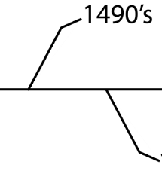
The Meats Industry
Has a long history in the United States
the first longhorn cattle were brought to the Americas by the Spaniards in the 1490s
Is constantly increasing its knowledge related to food safety
Is regulated on a federal level by legislative action

Slide 8
Legislation
Implemented the federal and state regulation of antemortem and postmortem inspection of meat animals
Established approved harvesting procedures of animals, with some exceptions allowed for religious slaughter
Sets critical levels for bacteria and illness

Slide 9
Important Legislation
Includes:
Meat Inspection Act, 1906
Pure Food and Drug Act, 1906
Packers and Stockyards Act, 1921
Humane Slaughter Act, 1958
Wholesome Meat Act, 1967
Humane Methods of Slaughter Act, 1978

Slide 10
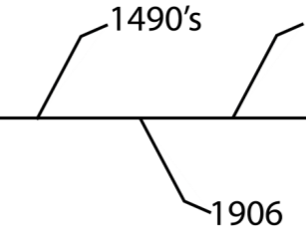
The Meat Inspection Act
Was enacted on June 30, 1906, to prevent the adulteration and misbranding of meat products
Was prompted by the publishing of The Jungle by Upton Sinclair
exposed the conditions of immigrants working in the U.S.
brought attention to conditions in meat processing plants

Slide 11
The Meat Inspection Act
Had four main impacts on the industry:
antemortem inspection of all livestock before slaughter
postmortem inspection of every carcass
sanitary conditions in all meat processing facilities
authorized the United States Department of Agriculture (USDA) to monitor and inspect all harvesting and processing operations

Slide 12
The Pure Food and Drug Act
Was enacted the same day as the Meat Inspection Act
Provided for federal inspection of all meat products
Prohibits the sale, manufacture and transportation of adulterated food products
Paved the way for the creation of the Food and Drug Administration (FDA)

Slide 13
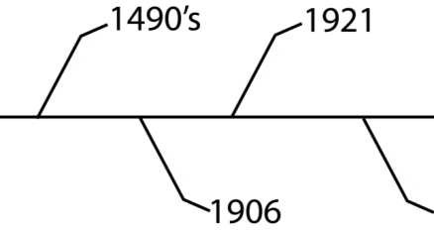
The Packers and Stockyards Act
Was enacted on June 15, 1921
Gave the Secretary of Agriculture and the USDA authorization to regulate livestock marketing and meat packing
monitoring of scales and brands
Has been amended five times:
1958, 1976, 1987, 2000 and 2002

Slide 14
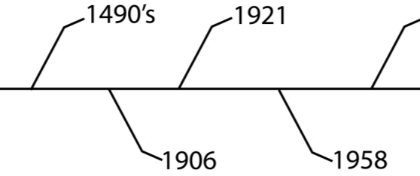
The Humane Slaughter Act
Was originally passed in 1958
Was required for animals whose meat would be sold to federal agencies
Applied to only cattle, horses, mules, sheep and swine
Has been amended and the law, now enforced by the Food Safety and Inspection Service (FSIS), was passed in 1978

Slide 15
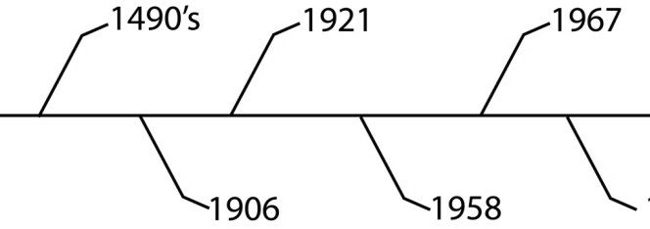
The Wholesome Meat Act
Was the amendment to the Meat Inspection Act of 1906
Was passed in 1967
Requires state inspection of processing facilities to equal or exceed federal inspection standards

Slide 16
The Wholesome Meat Act
Requires a federal, USDA or state inspection mark
mark can be found on the can, package and/or primal cuts of meat
Assures meat is from healthy animals, harvested and processed under sanitary conditions
Meat Moment: The federal or state inspection mark indicates wholesomeness, not quality.

Slide 17
Uniform Retail Meat Identity Standards
Was implemented by the meats industry in 1973
Established a single, specific name for each basic retail cut
Increased the amount of information found on the label of a meat package
Is a voluntary program

Slide 18
The Humane Methods of Slaughter Act
Amended the Humane Slaughter Act
Was passed in 1978
Clearly outlines handling, stunning and harvesting procedures
Lists the approved stunning methods
captive bolt stunner
electric shock
carbon dioxide gas

Slide 19
The Humane Methods of Slaughter Act
Allows exceptions for ritual slaughtering practices
Halal: method of slaughter, meat processing and handling according to Islamic dietary laws in accordance with the Quran
Kosher: method of slaughter, meat processing and handling according to the Jewish dietary laws in accordance with the Torah
Meat Moment: Halal is Arabic for “permitted” or “lawful.” Kosher is Hebrew for “properly prepared.”

Slide 20
The Hazard Analysis Critical Control Point Approach to Food Safety
Is most commonly referred to as HACCP
Was first implemented in the 1950s by the Pillsbury Company in the manufacturing of food for NASA astronauts
Is a process of identifying possible sources of food adulteration during processing
Must be in place in all federal and state inspected meat and food processing facilities in the U.S.

Slide 21
The Nutritional Labeling & Education Act
Was passed in 1990
Required nutritional information labels on all food products except single ingredient foods, such as fresh meat
nutritional labels were voluntary until 1990
Meat Moment: Food is deemed “misbranded” unless it has a nutritional label.

Slide 22
The Nutritional Labeling & Education Act
Requires the following information on a nutritional label:
serving size
number of servings per container
number of calories per serving
number of calories from total fat and saturated fat
amount of total fat, saturated fat, cholesterol, sodium, total carbohydrates, complex carbohydrates, sugars, total proteins and dietary fiber per serving
vitamins, minerals or other nutrients

Slide 23
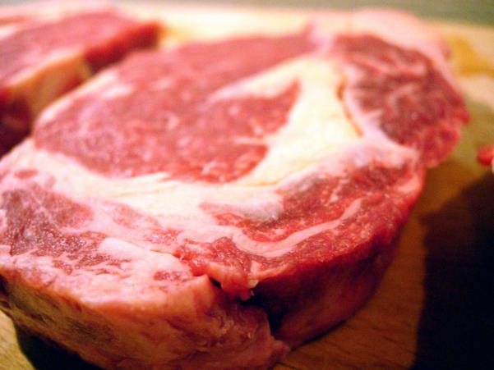
The Nutritional Labeling & Education Act
Was amended to require the nutritional labeling of single ingredient meat products in 2011
labeling began in January 2012

Slide 24
Other Important Dates in Meat Science & Food Safety
1993: The first Escherichia coli 0157:H7 outbreak is traced to ground beef from the major fast food chain Jack in the Box®; the USDA requires meat processors to test for this pathogen and considers it an adulterant in ground beef
1994: FSIS releases the Safe Food Handling label; required on all raw meat products
1997: The FDA Modernization Act implements the broadest changes to the foods industry since 1938

Slide 25
Other Important Dates in Meat Science & Food Safety
2002: The FDA requires nutritional labels to include trans-fat content
2011: The USDA announces plans to require mandatory testing for six more serogroups of E. coli in addition to 0157:H7 including: O26, O103, O45, O111, O121, and O145
Safety Second: FSIS is constantly updating its food safety protocols and posts this information at http://www.fsis.usda.gov.

Slide 27
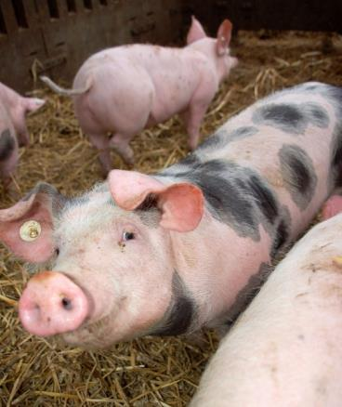
Live Animal Care
Has a significant impact on cutability and meat quality
Is important from farm to processor
Includes factors such as:
growth hormone implants
antibiotics
water and feed
illness
handling practices
weather

Slide 28
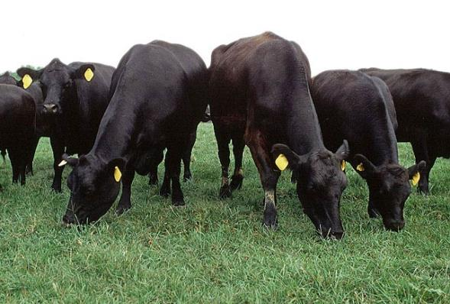
Growth-Promoting Implants
Are used in cattle and sheep to increase rate of growth and weight gain
increase feed efficiency
aid in muscle growth and influence carcass traits

Slide 29
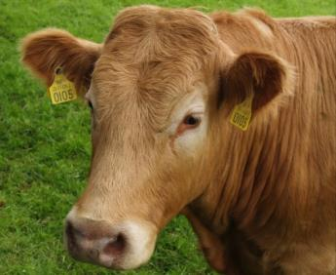
Growth-Promoting Implants
Contain either natural or synthetic hormones
natural hormones are gender-based hormones
estradiol
progesterone
testosterone
synthetic hormones are based on natural hormones but modified in a lab
zeranal
trenbolone acetate

Slide 30
Growth-Promoting Implants
Are placed in the ear of cattle or sheep
Must be approved by the FDA for use
determine use
establish limits
create tolerance levels
establish and enforce withdrawal period
Are NOT approved for use in swine or poultry

Slide 31
Beta-agonists
Are synthetic chemicals which shift nutrients away from fat production to the promotions of lean muscle growth
Allowed in the United States are:
ractopamine hydrochloride manufactured by Elanco Animal Health under the name Optaflexx® for cattle and Paylean® for swine
zilpaterol hydrochloride manufactured by Intervet under the name of Zilmax® and approved for cattle

Slide 32
Antibiotics
Are used to prevent and treat illness in livestock animals
Help maintain a steady supply of meat from healthy animals
Can be used in two manners:
administered in small, preventative doses through feed and water; known as sub-therapeutic use
administered in larger doses to treat illness

Slide 33
Antibiotics
Must be approved for the intended use by the FDA before administered to livestock
Have withdrawal periods which are set by the FDA and must be followed

Slide 34
Withdrawal Period
Is the prescribed period of time the meat animal must not have received the compound or drug immediately preceding harvest
Will allow ample time for the drug or hormone to pass through the animal’s system
Are set by the FDA and monitored through testing by FSIS
Safety Second: FSIS collects approximately 1.5 million samples per year from meat products to test for hormone and antibiotic residues.

Slide 35
Residue Levels
Are the amounts of a drug, antibiotic or hormone left behind in a product after the withdrawal period has passed
Are monitored by the USDA, FSIS, FDA and Environmental Protection Agency (EPA)
Related to antibiotics and other drugs can be reduced below violative levels by veterinarians abiding by rules set by the FDA

Slide 36
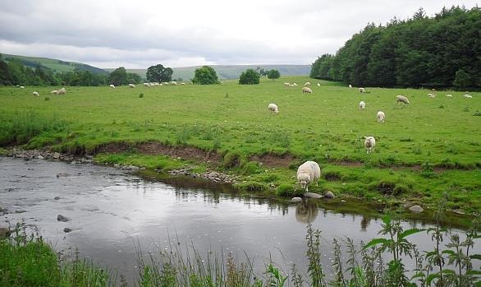
Water
Is essential to all life processes
Must be provided to livestock throughout the life cycle until the point of harvest
Aids in ease of hide removal and evisceration

Slide 37
Feed & Feedstuffs
Provide all essential and non-essential nutrients
Provide the source of energy for the animal to perform life processes, growth and development
Are withheld from animals 12 hours prior to slaughter to aid in evisceration and reduce the likelihood of microbial contamination from visceral punctures

Slide 38
Illness in Livestock
Should be addressed immediately
May prevent an animal from being harvested or cause its carcass to be condemned
Can be treated with antibiotics
Safety Second: It is vital to read the label of any drug given to an animal as it may delay the time of harvest due to mandatory withdrawal periods.

Slide 39
Illness in Livestock
Should result in the ill animals being separated from other healthy animals
Due to regulations concerning Bovine Spongiform Encephalopathy (BSE), non-ambulatory or “downer” cattle cannot be harvested for human or animal consumption
Is monitored by veterinarians who are employed by producers, processors and the federal government

Slide 40
Handling Procedures
May influence red meat yield due to bruising and meat quality
Should aim to prevent injury and stress to the animal
Include:
not shipping horned cattle in confined spaces to prevent bruising
properly using sorting sticks to prevent bruising and lesions
designing working facilities to minimize stress and injury
avoiding short-term stress in swine immediately prior to slaughter to prevent meat quality issues
preventing long-term stress in all livestock to prevent degradation of meat quality

Slide 41
Adverse Weather Conditions
Can increase the incidence of illness in animals due to rapid changes
hot to cold
dry to wet
Should be monitored during high stress situations in an animal’s life
calving, farrowing and lambing
weaning
shipping

Slide 42
Adverse Weather Conditions
Can effect rate of gain
in exceptionally hot weather, animals will consume less feed, reducing gain
in exceptionally cold weather, animals will consume more feed, utilizing the energy to maintain body temperature, not add weight
Are out of the producer’s and processor’s control, but its effects can be mediated through proper handling and monitoring procedures

Slide 44
Meat in the Diet
Is important as it is a source of complete protein
contains all nine essential amino acids
Provides significant amounts of essential and non-essential micronutrients
Is measured in cooked ounces
the daily recommendation of protein in the diet differs by age and sex and is measured in protein ounce equivalents

Slide 45
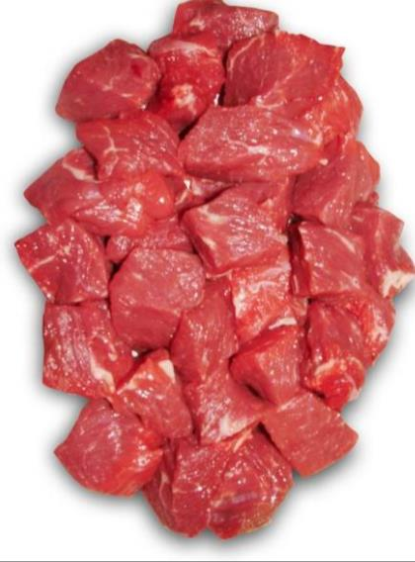
The Components of Meat
Are essential to good health
Include:
protein
fat
fat-soluble vitamins
B-vitamins
iron
essential minerals
water

Slide 46
Protein
Is responsible for body structure and chemical reactions essential to life
aid in the repair and maintenance of body cells
Strengthens the body’s immune system against infections and disease
Maintains blood neutrality
pH 7.35 to 7.45
Is most readily absorbed from natural sources such as meat

Slide 47
Protein
Found in meat contain the essential amino acids:
Histidine
Isoleucine
Leucine
Lysine
Methionine
Phenylalanine
Threonine
Tryptophan
Valine
Meat Moment: Our bodies cannot synthesize essential amino acids so they must be consumed from dietary sources. Arginine is an essential amino acid for children, but not adults.

Slide 48
Protein
Aids in the regulation of the water balance in the body
the human body is 60 percent water (H₂O)
Can be obtained from all meat and poultry products
an ounce of meat or poultry contains an average of 7 grams of protein
Meat Moment: How many grams of protein are in a six ounce lamb rib chop?
(6 ounces x 7 grams/ounce)= 42 grams of protein

Slide 49
Fat
Is essential for the absorption of fat-soluble vitamins A, D, E and K
Contain the most energy per gram
9kcal/gram
Are made up of triglycerides, found in three natural forms:
monounsaturated
polyunsaturated
saturated
Meat Moment: Saturated fats contain only single bonds between carbon atoms; unsaturated fats contain one or more double bonds between carbon atoms.

Slide 50
Fat
In a serving of lean meat, is less than the fat in an eight ounce glass of whole milk
serving size of lean meat is three and a half ounces
Found in beef, pork and veal, is less than 50 percent saturated
saturated fats are typically viewed as “bad” fats
Also contains cholesterol
Meat Moment: Less than 30 percent of a person’s daily caloric intake should be from fats.

Slide 51
Cholesterol
Is a sterol
waxy alcohol found in animal tissues and products
Is used to:
synthesize vitamin D
create hormones
form bile salts to aid in digestion of fats
Coats nervous system tissues, facilitating nerve impulse transmission

Slide 52
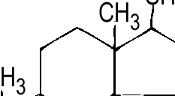
Cholesterol
Can be obtained from dietary sources or produced by the body
the liver may produce two to three times more cholesterol than a person consumes

Slide 53
B Vitamins
Are water soluble vitamins
Aid the body in obtaining energy from food
Help to build red blood cells
Found in meat and organ meats, include:
thiamine (B1)
riboflavin (B2)
niacin (B3)
B6
biotin (B7)
B12
folic acid

Slide 54
Essential Minerals
Must be obtained from dietary sources
Aid in the regulation of body processes
Found in meat include:
Copper
Iron
Magnesium
Manganese
Phosphorus
Potassium
Selenium
Zinc
Meat Moment: Vegetarians are challenged in maintaining sufficient levels of amino acids, vitamins, calcium, iron and zinc. Many vegetarians must include nutritional supplements in their diet.

Slide 55
Iron from Meat
Is the best food source of heme iron
heme iron is the most readily absorbed form of iron
Is essential for:
formation of red blood cells
enhancing the absorption of non-heme iron
Meat Moment: The human body absorbs one to 14 times more heme iron than non-heme iron. A person with low blood iron levels is considered iron deficient anemic.

Slide 56
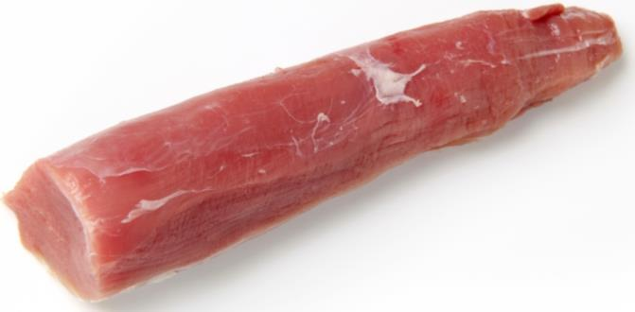
Ounce for Ounce
Lean meat contains less calories than some fruits and vegetables
Lean meat contains less fat than:
peanut butter
cheddar, Swiss and American cheeses

Slide 57
Three Ounces of Lean Meat
Contains less than 200 calories
Can contain many of one’s daily nutrients:
beef: more than half of the protein required for females over 14
pork: 39 percent of the Recommended Daily Allowance (RDA) for zinc
lamb: 74 percent of the RDA for Vitamin B12

Slide 59
Muscles
Are comprised of thousands of basic muscle contractile units known as sarcomeres
Consist of two primary contractile proteins, myosin and actin
myosin is the thick myofilament in the sarcomere
actin is the thin myofilament in the sarcomere
Are converted to meat postmortem
meat varies in tenderness based on the muscle it is from
Meat Moment: As a general guide, tenderness decreases the farther away from the center of the carcass the cut of meat is from.

Slide 60
Sarcomere
Muscle
Muscle Bundle
Muscle Fiber
Sarcomere

Slide 61
Primal Cuts
Are the large pieces into which a carcass is divided
Break down into sub-primal cuts, then retail cuts
Are known by different names for each species

Slide 62
Primal Cuts: Beef

Slide 63
Primal Cuts: Pork

Slide 64
Primal Cuts: Lamb

Slide 65
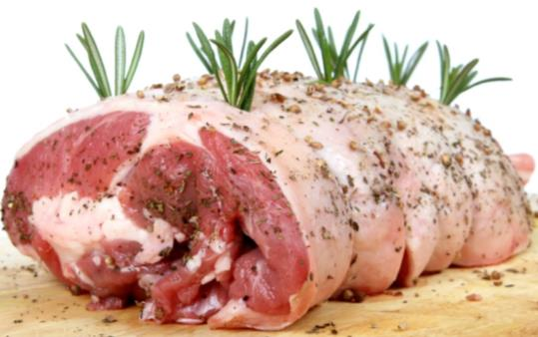
Sub-Primal Cuts
Are smaller portions of primal cuts
example: chuck roll from the chuck in beef
Can be cut into roast, steaks and other smaller portions to be purchased at retail establishments

Slide 66
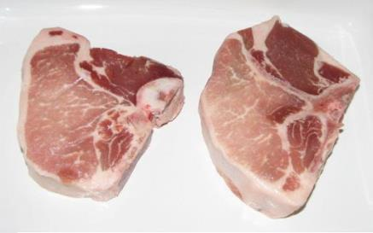
Retail Cuts
Are the portions of meat sold in retail establishments, such as grocery stores
Are labeled on a uniform basis according to the Uniform Retail Meat Identity Standards
a pork sirloin chop in California is the same cut as a pork sirloin chop in Maine

Slide 67
Ground Beef vs. Hamburger
Ground Beef | Hamburger
Consists of chopped, fresh or frozen beef, with or without seasoning, and without the addition of beef fat | May contain added beef fat, up to 30 percent of the total
Shall NOT contain more than 30 percent fat | May contain seasoning if listed on the label
Shall NOT contain any added water, phosphates, binders or extenders | Shall NOT contain any added water, phosphates, binders or extenders
Meat Moment: According to USDA regulations, if ground beef or hamburger contains more than 30 percent fat, it is considered “adulterated” and the establishment selling the product is subject to fines.

Slide 68
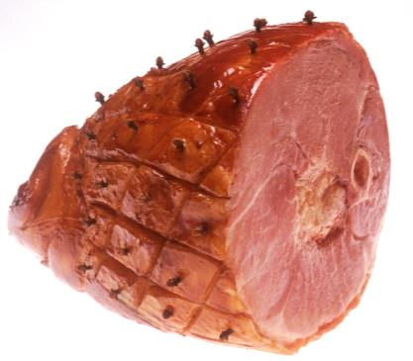
Fresh Ham vs. Water-Added Ham
Fresh Ham | Water-Added Ham
Is the hind leg of a hog | Is part of the hind leg of a hog
Has NOT been cured or smoked | Uses water as an essential part of the curing process
May be sold bone-in or boneless | Shall NOT contain more than 10 percent of the fresh, uncured weight of the ham in added moisture

Slide 69
Retail Packaging
Has three common methods:
overwrap
modified atmosphere packaging
vacuum packaging
Meat Moment: The meat and poultry industries produce more than 92 billion pounds of product in the United States alone, equaling almost 300 pounds per U.S. citizen.

Slide 70
Overwrap
Is usually done in the retail establishment
Is a plastic wrapping over the product and tray

Slide 71
Modified Atmosphere Packaging
Is the packaging of meat in a tray with a mix of gases different from the normal composition of our atmosphere
Uses mixes of carbon dioxide, oxygen and other inert gases
common mix is 80 percent oxygen and 20 percent carbon dioxide

Slide 72
Vacuum Packaging
Eliminates almost all air from the package
Causes fresh meat to appear dark until exposed to air
Results in a distinct odor after opening which quickly dissipates
Has two main advantages:
increases length of time meat can be kept
decreases shrinkage of meat due to moisture loss

Slide 73
Labeling
Is required on all meat products by the FSIS
Requirements include:
product name
inspection mark
establishment number
name and address of producer or distributor
net weight statement
ingredient list
handling instructions

Slide 74
Net Weight
Is the total weight of the food product, minus the weight of the packaging materials
example: Two lamb chops weighing four ounces each are packaged in three ounces of packaging. What is the net weight of the product?
answer: (2 x 4 oz.) – 3 oz. = 5 oz. net weight

Slide 75
Net Weight
May change from packaging to counter due to moisture loss during processing and shipping
Meat Moment: To calculate the cost per serving of meat, divide the cost per pound of the meat bought by the number of servings you expect per pound.

Slide 76
Product Date
Is not an FSIS requirement
Can be worded in several manners
“Best if Used By”
should be used by this date for the best taste and texture
“Use By”
denotes the date by which product should be used and still be considered safe
“Sell by Date”
food product should be sold by this date
the consumer has a reasonable time after purchase for use
Meat Moment: “Use By” labels may also sometimes include “Or Freeze By.” Consumers MUST pay attention to this date, especially with MAP packaged products due to the delay in spoiled appearances.

Slide 77
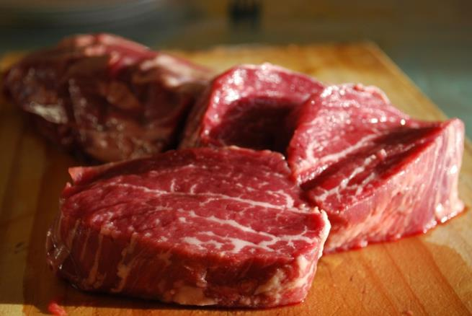
Types of Differentiated Products
Can be a type of marketing, treatment or program monitored by the USDA
Examples:
branded programs
aged
organic

Slide 78
Branded Programs
Have standards for qualification
Place a premium price on their product
Are viewed as a luxury item with guaranteed quality
Examples:
Certified Angus Beef®
Nolan Ryan’s Guaranteed Tender Beef
Chairman’s Reserve® Premium Pork

Slide 79
Aging of Meat
Develops additional tenderness and flavor
Requires strict control of factors such as:
temperature
to control microbial growth and rate of tenderization
humidity
to control dehydration
Is not recommended for at-home consumers
Meat Moment: Beef is the most commonly aged meat. Pork and lamb are harvested at a much younger age, resulting in meat which is naturally more tender.

Slide 80
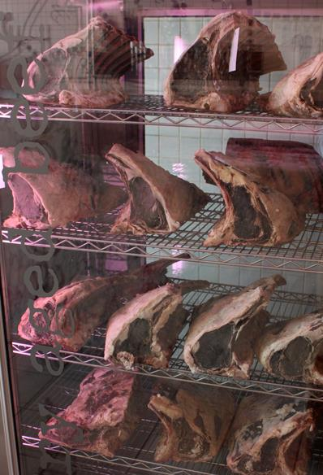
Aging Methods
Include:
dry aging
meat is held for ten days to six weeks at 34º to 38ºF (1º-3ºC) in a humidity controlled cooler
wet aging
meat is vacuum packaged in moisture-proof vapor film, then refrigerated for various time periods based on cut and presence of bones

Slide 81
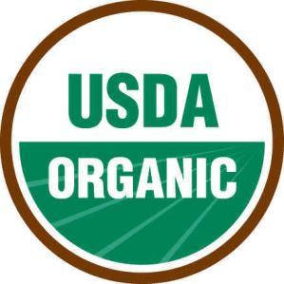
Certified Organic
Is monitored by the USDA’s National Organic Program (NOP)
Has specific rules to obtain organic status

Slide 82
Organic Meat
Originates from animals which have only consumed certified organic feed and feedstuffs, forages and pasture
Is from animals which have not received antibiotics
antibiotics can be used to treat disease; however, the animal will lose its organic status

Slide 83
Organic Meat
Can be from animals which have received vaccines but no growth-promoting agents
NOP rules dictate which vaccines allow an animal to keep its organic status
Is processed in a facility approved for organic meat processing
Receives a higher than market price at retail
Safety Second: ALL food safety procedures and practices supersede organic regulations.

Slide 84
Natural
Is a labeling term monitored by the FSIS
“A product containing no artificial ingredient or added color and is only minimally processed. Minimal processing means that the product was processed in a manner that does not fundamentally alter the product. The label must include a statement explaining the meaning of the term natural (such as "no artificial ingredients; minimally processed").”- Meat and Poultry Labeling Terms, FSIS, 2011

Slide 85
Maturity Classes
Divide meat into categories based on age
Applies mainly for red meat animals (i.e., cattle and sheep)
Are not used for pork; most hogs in the United States are harvested at approximately the same age
Safety Second: Beef harvested for export to Japan from the United States must be under 18 months of age.

Slide 86
Beef Maturity Classifications
Bob Veal | Veal | Baby Beef | Short-Fed | Long-Fed
From calves under 150 lb. | From calves under one year of age | From cattle with a live weight of <700 lb.; also known as calf | Cattle fed in a feedlot from 90 to 130 days, 750-850 lb., live weight | Cattle fed in a feedlot for more than 130 days
 | Desired for tenderness, flavor and pale color | Strictly fed milk and grass; have yellow fat color due to carotene in grass | Good cutability with little to no excess fat | Lower cutability and higher chances of carrying excessive fat

Slide 87
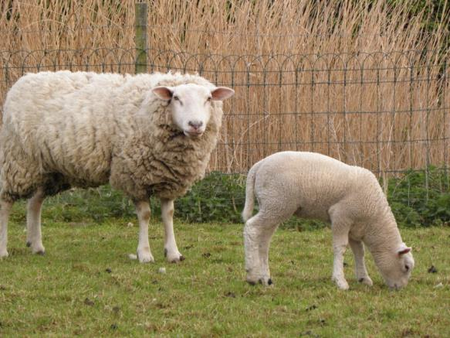
Lamb Age Classes
Lamb | Mutton
Meat from a young sheep less than one year of age | Meat from a sheep more than one year of age
Tender and mild in flavor | More intense flavor; preferred in some cultures over lamb

Slide 88
Yield Grades
Are the numerical measurement of the percentage boneless, closely trimmed retail cuts (%BCTRC) of a carcass
cutability
For beef and lamb are represented by numbers 1 to 5
Yield Grade | %BCTRC
1 | > 52.3
2 | 52.3-50.0
3 | 50.0-47.7
4 | 47.7-45.4
5 | < 45.4

Slide 89
Quality Grading
Is most commonly discussed in relation to beef
Is a voluntary practice, paid for by the producer and processor
Is performed by the USDA Agricultural Marketing Service
Serves as a predictor of palatability
tenderness, juiciness and flavor of the cooked product

Slide 90
Quality Grades
In beef, factors evaluated include:
physiological age of the carcass known as carcass maturity score (A, B, C, D, E)
physiological age is an estimate of the actual chronological age
marbling
small flecks of fat within the ribeye muscle
color, firmness and texture of lean color

Slide 91
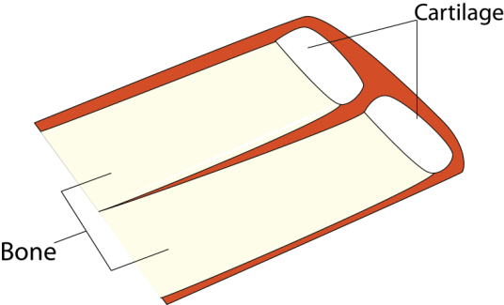
Carcass Maturity Score
Is determined by examining the amount of ossification in the cartilaginous buttons on the sacral and lumbar vertebrae
Divides carcasses into five maturity groups
Carcass Maturity | Percent Ossification | Approximate Live Age (Months)
A | 0-10 | 9-30
B | 10-35 | 30-42
C | 35-70 | 42-72
D | 70-90 | 72-96
E | > 90 | > 96
http://meat.tamu.edu

Slide 92
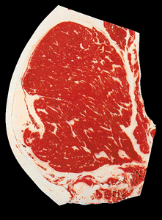
Lean Evaluation
Includes:
degree of marbling
color
bright cherry red is ideal
firmness
texture

Slide 93
Degrees of Marbling
Grade for “A” Maturity Beef | Marbling Score
Prime + | Abundant⁰⁻¹⁰⁰
Prime º | Moderately Abundant⁰⁻¹⁰⁰
Prime – | Slightly Abundant⁰⁻¹⁰⁰
Choice + | Moderate⁰⁻¹⁰⁰
Choiceº | Modest⁰⁻¹⁰⁰
Choice– | Small⁰⁻¹⁰⁰
Select + | Slight⁵⁰⁻¹⁰⁰
Select– | Slight⁰⁻⁴⁹
Standard + | Traces⁰⁰⁻¹⁰⁰
Standard– | Practically Devoid⁰⁻¹⁰⁰
http://meat.tamu.edu

Slide 94
Quality Grades
In lamb, factors evaluated include:
physiological age of the carcass
flank fat streaking
lean and external fat color and firmness
conformation

Slide 95
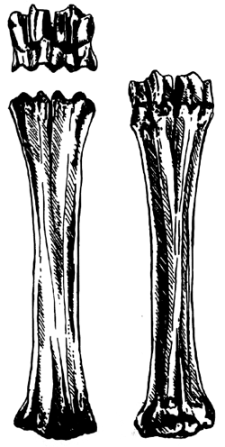
Physiological Age of Lamb
Is determined by evaluating the joints of the front shank joints and ribs
left is a break joint, right is a spool joint
ribs will be varying degrees of round and red or flat and white
Joints | Age(Months) | Classification
2 break | 2-14 | Lamb
1 break, 1 spool | 12-25 | Young Mutton
2 spool | > 25 | Mutton

Slide 96
Fat Evaluation of Lamb
Is examined at the flank, along with internal and external fat covering
internal and external fat is examined for color and firmness, not just amount
Meat Moment: Which lamb is fatter, the one on the right or left? How can you tell?

Slide 97
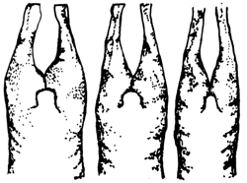
Conformation in Lamb
Is an indicator of carcass muscling
the higher the number, the heavier muscled the carcass
Utilizes numbers one to 15
the higher the number, the higher the muscle to bone ratio should be

Slide 98
USDA Quality Grades
For beef includes:
Prime
Choice
Select
Standard
Commercial
Utility
Cutter
Canner
For lamb includes:
Prime
Choice
Good
Utility
Cull
Meat Moment: Approximately two percent of graded beef in the U.S. grades at USDA Prime.

Slide 99
Quality Grades
Are stamped on the carcasses by a USDA Grader
Are an important marketing tool
more than 90 percent of the lambs slaughtered in the U.S. grade USDA Choice or higher
most of the beef in U.S. grocery stores is USDA Select with some USDA Choice, Prime and branded programs

Slide 101
SUBCHAPTERS
Meat Storage
Meat Handling

Slide 102
Refrigerator Storage Times
Are affected by temperature
lower temperatures increase storage time
Are designed to provide the consumer with a safe product which has retained its quality
Limit bacterial growth on meat’s surface and within ground products
Safety Second: Bacteria will still grow at refrigeration temperatures (40ºF-33ºF, 4ºC-0ºC), but much slower than at room temperature (72ºF, 22ºC).

Slide 103
Refrigerator Storage Times
Fresh, uncooked meats:
Retail Product | Storage Time (days)
Beef | 3-4
Ground meats | 1-2
Lamb | 3-5
Pork | 2-3
Variety meats | 1-2
Veal | 1-2
http://www.fsis.usda.gov, 2011

Slide 104
Refrigerator Storage Times
Processed meats:
Processed Product | Storage Time
Bacon | 1 week, if vacuum packaged
Frankfurters | 3-5 days
Sausage | 1 week
Smoked whole ham | 1 week
http://www.fsis.usda.gov, 2011

Slide 105
Freezer Storage
Should be at or below 0ºF (-18ºC)
Long term
should be in a deep-freeze type freezer or in a unit which separates the freezer from the refrigerator
Short term
single door freezer/refrigerators should only be used for short-term storage of previously frozen meats
Meat Moment: If repackaging meat before freezer storage, choose a moisture-proof wrap, such as freezer storage bags, heavyweight plastic wrap, aluminum foil or freezer paper coated with plastic.

Slide 106
Freezer Storage
Keeps meat safe to eat as long as the meat has remained frozen
Can cause the quality of meat to deteriorate
May result in freezer burn or oxidative changes in the meat
Meat Moment: Rancidity is the result of oxidative changes in fat found in foods and can result in undesirable off-flavors, aromas and textures.

Slide 107
Freezer Burn
Is the dehydration of the surface tissues of a food
Can be caused by:
improperly wrapping foods
punctures in the packaging which allow freezer air to come in contact with the food
Compromises palatibility
toughens food
results in rancid or tasteless cooked food

Slide 108
Freezer Storage Times
Fresh, uncooked meats:
Retail Product | Storage Time (months)
Beef | 6-12
Ground beef, veal and lamb | 3-4
Ground pork | 1-3
Pork | 6
Variety meats | 3-4
Veal and lamb cuts | 6-9
http://www.fsis.usda.gov, 2011

Slide 109
Freezer Storage Times
Processed meats:
Processed Product | Storage Time (months)
Bacon | 1
Frankfurters | 1-2
Sausage | 1-2
Smoked whole ham | 1-2
http://www.fsis.usda.gov, 2011

Slide 110
Variables of Home Freezer Storage
Include:
condition of the meat when frozen
How long was the meat refrigerated before freezing?
wrapping material and method
Was an air- and moisture-proof wrapping material used?
rate of freezing
thin cuts or packages of meat will freeze faster than thick cuts or packages
temperature of freezer
meat will retain its quality best and freeze quickest if stored in a very cold freezer (<-10ºF, -23ºC)

Slide 111
After a Power Outage
Meat in the refrigerator is safe for six to eight hours, unless meat temperature rises above 40ºF (4ºC) for more than two hours
Meat in the freezer is safe for two days if freezer is at full capacity
Safety Second: When power fails, do NOT continuously open refrigerator door to check the temperature.
http://www.fsis.usda.gov, 2011

Slide 112
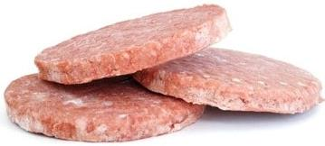
Re-Freezing Meat
Can cause some deterioration of quality
meat could lose juiciness
Safety Second: Raw meat which has been at room temperature for more than two hours should not be consumed or re-frozen.

Slide 113
Safe Handling Instructions
Are required by the USDA on all labels of raw meat and poultry products
Can be found on all meat and poultry products packaged at federally inspected plants and retail establishments (e.g., grocery stores)

Slide 114
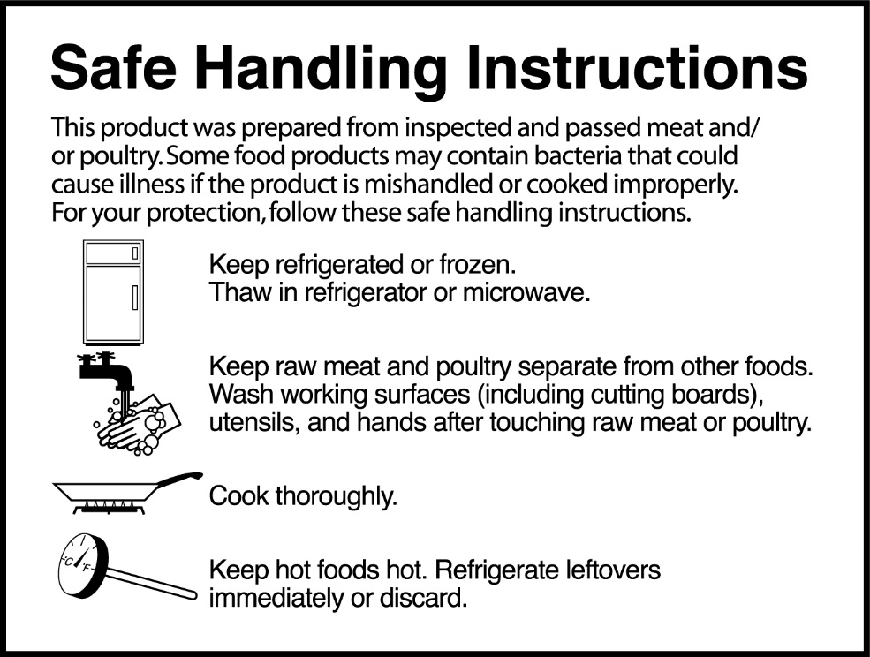
Safe Handling Instructions
Are the same on all types of raw meat and poultry
Are regulated by FSIS

Slide 115
Food Safety Tips at Home
Based on the Safe Handling Instructions include the following:
BEFORE handling raw meat, poultry or seafood, cooked foods or foods which will be eaten without cooking, WASH HANDS
use CLEAN utensils and work surfaces
AFTER handling raw meat, poultry or seafood, wash hands and work surfaces with hot, soapy water

Slide 116
Cross-Contamination
Is the spread of harmful, pathogenic bacteria from one surface to another, one surface to a person, or person-to-person
Can be caused by raw products such as meat, poultry, seafood or vegetables
Safety Second: Pathogenic bacteria cause illnesses. Commonly known foodborne pathogenic bacteria includes: Escherichia coli 0157:H7, Campylobacter jejuni and Salmonella spp.

Slide 117
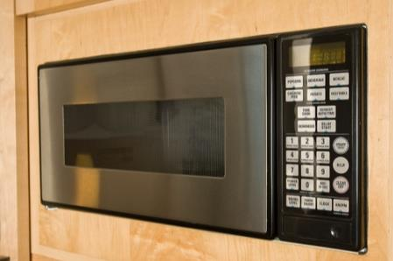
Defrosting Meat
Should be completed in one of three ways:
in a refrigerator
in cold water
in a microwave oven
Can be achieved quickest in a microwave oven

Slide 118
Defrosting Meat
Will cause ice crystals within the meat to melt
liquid is released from the ice which can result in breaking emulsions and a loss of juiciness
Can reveal a change in the original texture of the meat due to ice crystal formation during freezing
Meat Moment: Microwave defrosting will result in the greatest loss of juiciness.

Slide 119
Handling of Ground Beef
Includes:
choosing a clean, completely sealed, cold package at the store
placing the package in a plastic bag so the juices do not drip onto other food
refrigerating or freezing as soon as possible after leaving the store
storing on the bottom shelf of the refrigerator in a plastic bag
keeping refrigerated and using within two days

Slide 120
Cooking Frozen Meat
Can be satisfactorily achieved without defrosting
Will increase cooking time
Requires several modifications:
place meat farther from heat source
broil steaks and chops one and one-half to two-times longer
roasting time will increase one and one-third to one and one-half times

Slide 121
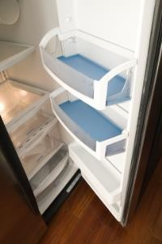
Handling Leftovers
Should be done as quickly as possible after cooking to cool food rapidly
Should have the ultimate goal of fast cooling to slow bacterial growth

Slide 122
Handling Leftovers
Includes:
dividing food into small, shallow containers
maintaining free air circulation around containers in refrigerators
avoiding placing large containers of food in refrigerators
large containers will cool slowly and unevenly as compared to a smaller container
Safety Second: Use cooked leftovers within four days.

Slide 123
Freezing Cooked Meat
Should be done quickly
Has steps which should be followed to maintain acceptable quality
after cooking, remove all bones
leave pieces of meat large
wrap tightly in moisture-proof material
seal and freeze quickly
temperature of freezer should be 0ºF (-4ºC) or lower

Slide 125
Before Cooking Meat
Remember, timetables are based on meat at refrigerator temperature
partially frozen meat will require a longer cooking time
Make sure meat has not reached room temperature
increases chances of harmful bacterial growth

Slide 126
Cooking Temperatures
Should not be too high (i.e. 325º F (162ºC) or less for oven roasting)
Can increase shrinkage and cooking loss, and decrease tenderness and juiciness if too high
When too high (above 325º F,162ºC), can result in overcooking
increased cost per serving due to shrinkage and loss

Slide 127
Internal Temperature
Is the temperature of meat in the center of the thickest portion of the cut
Must be monitored to ensure killing of harmful bacteria and maximizing palatability
Is higher for ground products versus whole muscle products (e.g., ground beef versus ribeye steak)

Slide 128
Internal Temperatures of Beef & Lamb
Include:
Product | Minimum Internal Temperature, ºF
Ground | 160
Roasts, Steaks and Chops | Rare: 125
 | Medium Rare: 130
 | Medium: 140
 | Well Done: 160
Safety Second: Remember, the USDA recommends a safe internal temperature of whole muscle products to be at least 145ºF (63ºC).
http://fsis.usda.gov, 2011.

Slide 129
Internal Temperatures of Pork
Include:
Must reach at least 145ºF to kill bacteria and the Trichinella spiralis parasite if present
incidence of trichinosis is extremely rare in the U.S.
Product | Minimum Internal Temperature
Ground | 160ºF
Roasts, Steaks and Chops | 145ºF
Hams | 145ºF before serving
Meat Moment: Let meat sit for at least three minutes after removing from heat to allow temperature to “rest” and prevent juice loss.
http://fsis.usda.gov, 2011.

Slide 130
Browning of Meat
Contributes to the final taste of cooked meat
Is affected by:
amount of fat in meat
dryness of meat and meat surface
distance of meat from heat source
cooking temperature
cooking time

Slide 131
Cooking Methods
Differ based on the cut of meat
Include:
dry
used for more tender, higher quality cuts and ground products
moist
used for less tender cuts or those with large amounts of connective tissue

Slide 132
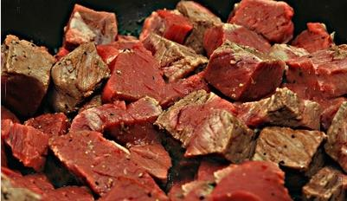
Dry Cooking Methods
Include:
broiling
convection oven cooking
deep fat frying
grilling
pan broiling
pan frying
roasting
smoking
stir frying

Slide 133
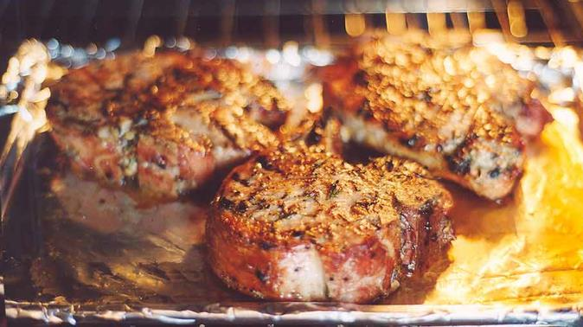
Broiling
Is recommended for tender steaks and chops at least three quarters to one inch in thickness
Uses heat from gas flames or electric coils in an oven

Slide 134
Broiling
Heats only the top surface of the meat
should be turned once for even cooking
Can result in excessive splattering and smoking, reduce by:
trimming excess fat
placing meat on rack in broiling pan
moving meat farther away from heat source

Slide 135
Convection Oven Cooking
Is recommended for tender cuts of beef, pork and lamb
Uses heated air circulated around the meat by a fan
Enables heated air to come in contact with all meat surfaces
meat cooks evenly in less time compared to oven roasting

Slide 136
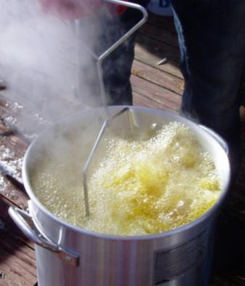
Deep Fat Frying
Immerses meat completely in hot fat
Is best completed when fat is between 350ºF and 360ºF (176ºC and 182ºC)
Requires the use of a thermometer to monitor fat temperature

Slide 137
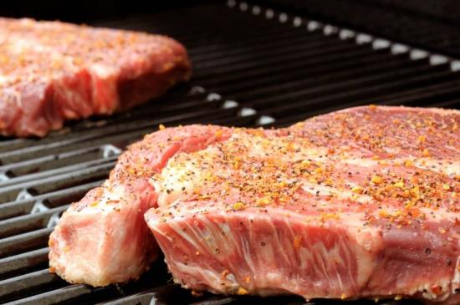
Grilling
Is recommended for steaks, chops and ground meat patties
Can be accomplished using hot coals, gas or infrared flames
Is similar to broiling
heat source is from one direction
Safety Second: Never use the same platter to carry raw and cooked meat without cleaning.

Slide 138
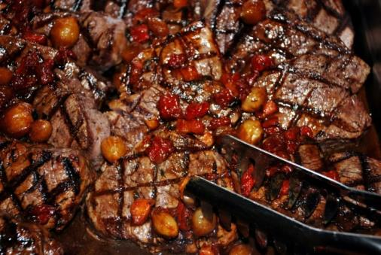
Pan Broiling
Is recommended for ground meat patties, steaks and chops less than one inch thick
Uses a heat source below the pan
Is accomplished by placing meat in a heavy, preheated non-stick skillet and cooking uncovered, turning only once

Slide 139
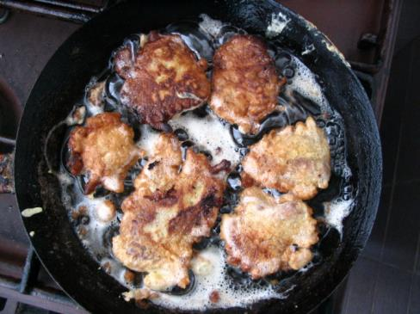
Pan Frying
Is recommended for thinner sliced meats
Browns both sides of the meat
Uses a small amount of fat in a skillet at moderate temperature
turn meat occasionally

Slide 140
Roasting
Is recommended for large cuts of meat
Should be conducted in shallow roasting pan, without covering the meat
Is usually completed in the oven or oven-type appliance

Slide 141
Roasting
Uses lower temperatures to cook meat
Enables the meat to be held in the oven for up to four hours before eating
less than two hours once cooked through will yield optimum eating quality
Meat Moment: Use a meat thermometer to check the internal temperature and remove from oven 5ºF to 10ºF (-15ºC and -12ºC) below desired temperature to allow meat time to sit.

Slide 142
Smoking Meats
Uses a smoker or covered grill and fragrant woods and spices
Is accomplished at lower temperatures
225ºF to 350ºF (107ºC to 176ºC)
Uses two thermometers
one to measure air temperature of smoker
one to measure internal temperature of meat

Slide 143
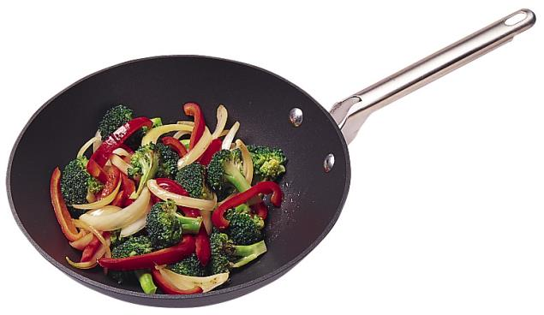
Stir Frying
Is recommended for thinly sliced meats
Uses only a small amount of fat in a very hot skillet
Combines meat with large amount of vegetables stirred constantly

Slide 144
Microwave Cooking
Can be used for fresh, whole muscle or ground cuts of beef, lamb and pork as well as processed meat products
Is quick and easy, though may result in different cooked texture in comparison to other cooking methods
Meat Moment: Browning of microwave-cooked meats can be increased by brushing the surface of the meat with a mixture of browning sauce and water.

Slide 145
Microwave Cooking
Methods:
bacon
four slices on a paper towel in a glass dish
microwave on high power for 40 to 60 seconds
pre-cooked sausages, such as frankfurters
pierce casings to vent steam and prevent casing from splitting
refer to manufacturer’s directions, usually 30 to 60 seconds and to an internal temperature of 160ºF (71ºC)

Slide 146
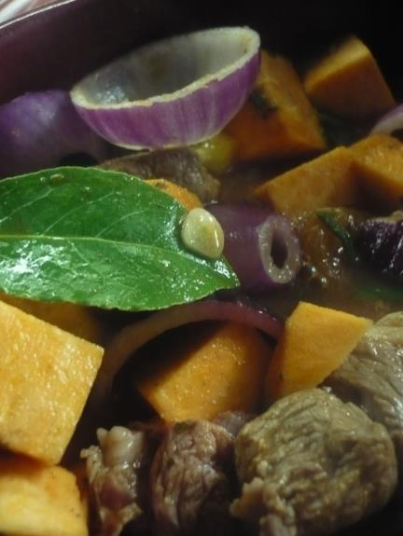
Moist Cooking Methods
Involve adding liquid to the container in which the meat is cooked, or allowing the meat to cook in its own juices
Include:
braising
stewing

Slide 147
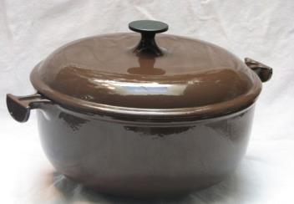
Braising
Is recommended for less tender cuts of meat high in connective tissue content
Is commonly referred to as “pot roasting”
Involves adding a small amount of liquid to the cooking container and covering the container
meat is cooked until “fork tender”

Slide 148
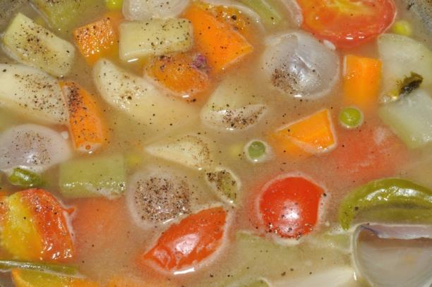
Stewing
Is recommended for smaller pieces of less tender cuts of meat
Involves completely covering the meat with liquid and cooking extensively
usually with vegetables

Slide 150
SUBCHAPTERS
Processed Meats
Additives

Slide 151
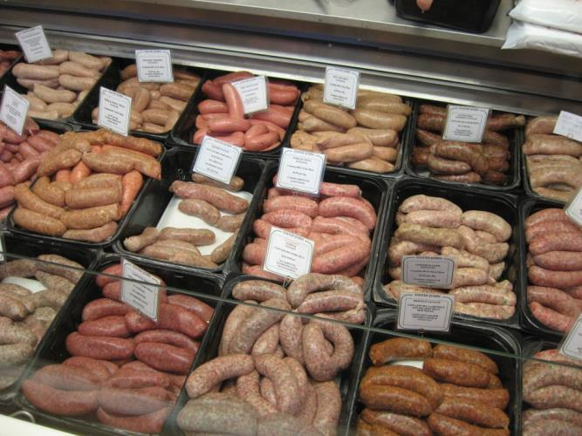
Processed Meats
Is a broad term used to identify chemically altered meat through cooking, curing, drying, or a combination
Can have added seasonings

Slide 152
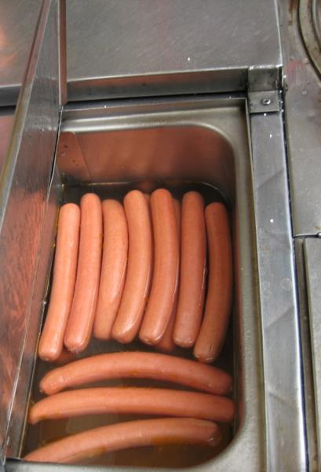
Processed Meats
Can require additional cooking or re-heating before consuming
Includes:
fresh and dried sausages
cold cuts
hams
bacon
frankfurters
canned meat products

Slide 153
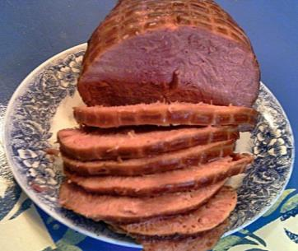
Processed Meats
Must have all ingredients listed on the label
ingredients are listed on the label in order of decreasing weight
the label and all ingredients must be approved by FSIS
Are inspected by FSIS

Slide 154
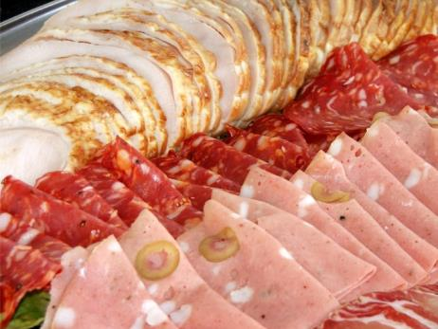
Cold Cuts
Are also known as luncheon meats
Contain only skeletal meats unless stated on the label
With variety meats, such as heart, liver or other meat sources, must be listed on the label
“with meat by-products”
“with variety meats”

Slide 155
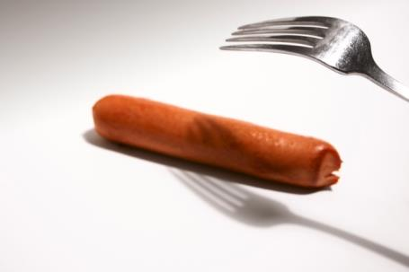
Frankfurters
Have ingredients which are monitored by FSIS
fat content may not exceed 30 percent by weight
if more than 10 percent water added by weight, product must be labeled “imitation”

Slide 156
Skeletal Meat
Is defined by the USDA as the edible muscle tissue of an animal attached to the bone
examples:
shoulder
brisket
Is used to make most processed meat products such as cold cuts and sausages
rack
pork belly

Slide 157
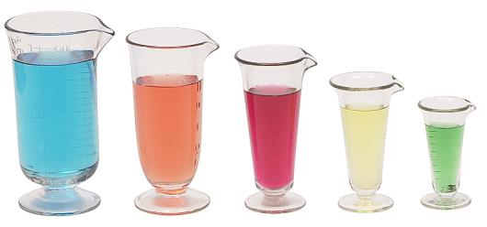
Food Additives
Are legally defined as, “any substance with the intended use of which results or may reasonably be expected to result — directly or indirectly — in its becoming a component or otherwise affecting the characteristics of any food”

Slide 158
Food Additives
Perform specific functions including flavoring, coloring, preserving, extending and/or improving, or maintaining a food’s natural appeal
Include naturally occurring ingredients such as sugar, and synthetic ingredients such as color additives
Meat Moment: Salt was one of the first food additives and has been used for millenniums to change the taste of and preserve foods.

Slide 159
Food Additives
Are used in processed meats to retard oxidation, for curing and flavoring, improving the product’s taste and look, as well as to discourage unwanted bacterial growth
Are added to processed meat products for flavor and preservation purposes
example: sodium chloride (NaCl) is added for flavor while sodium nitrite (NaNO₂) is added to prevent the growth of Clostridium botulinum

Slide 160
Antioxidants
Are compounds which absorb oxygen, reducing or preventing the oxidation of food
Used to prevent rancidity
Commonly used in the U.S. are butylated hydroxyanisole (BHA) and butylated hydroxytoluene (BHT)
both must be listed on the ingredients label and used according to FSIS regulations

Slide 161
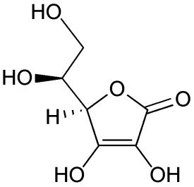
Antioxidants
Are used in processed meat
Ascorbic Acid (vitamin C)
used as a curing accelerator in combination with other curing agents to fix color at a faster rate or preserve color during storage

Slide 162
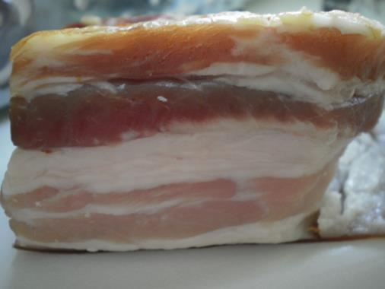
Curing Additives
Are used for preserving meats
Stabilize texture and flavor
Fix colors in sausages and smoked meats
Are essential to manufacturing processed meats such as:
bacon
ham
sausages

Slide 163
Curing Additives
Include sodium nitrite and potassium nitrate
contribute to the characteristic flavor and texture of bacon, ham and sausage products
correct and preserve meat color
can be toxic at high levels and their use is highly regulated in cured products
inhibit the growth of Clostridium botulinum, which could result in fatal food poisoning if consumed
Safety Second: The American Meat Institute petitioned FSIS to allow processors to reduce nitrate levels from 120ppm to 100ppm in bacon.

Slide 164
Flavorings
Contribute to, or are responsible for, the taste of a product
Are seasonings used in a food such as natural spices, essential oils, oleoresins, extracts and synthetic flavorings
Are divided into two types:
natural
synthetic

Slide 165
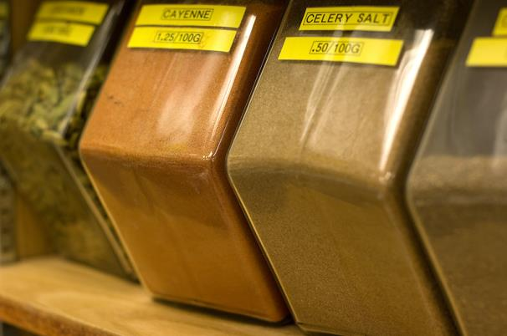
Natural Flavors
Are naturally occuring whole or ground spices
Are listed on the label as spice or flavoring
Include powdered vegetable products such as:
garlic
celery
onion
parsley

Slide 166
Natural Flavors
Such as salt or sodium chloride, and sucrose sugars are also food additives and must be listed on the label
sodium chloride is used in the manufacturing of almost all cured products and provides characteristic flavors and texture to processed meats
sucrose is used to develop or enhance flavor of a processed meat product
dextrose or corn syrup

Slide 167
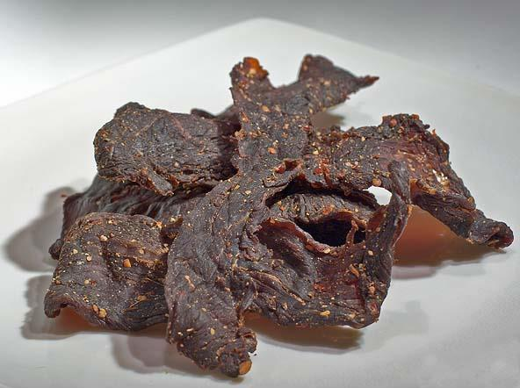
Synthetic Flavoring
Is any flavoring not an extract or naturally occurring flavor
Must be listed on the label as artificial flavoring
Examples include:
artificial sweeteners
some smoke flavorings

Slide 168
Meat Tenderizers
Are added to a meat product before cooking
Must be listed on the label
Include plant enzymes:
papain
used to tenderize natural smoked sausage casings
bromelain
ficin

Slide 169
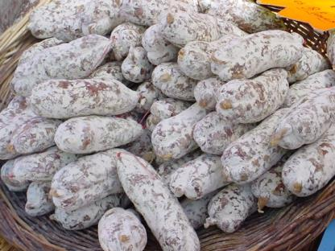
Potassium Sorbate
Is used to retard mold growth on the outside of dried sausages
pepperoni
salami

Slide 170
Starter Cultures
Are bacteria used for fermentation to create flavor and impart certain properties in processed meats
tangy flavor
reduce pH, thus reducing the rate of harmful bacterial growth
Do not contain harmful bacteria
Stop growing after a certain pH or temperature is reached during processing

Slide 171
Other Processed Meat Additives
Include:
isolated soy proteins
extracted proteins from soybeans; aid in binding lean and fat for improved product texture
lecithin
found naturally in soybeans, corn and eggs; aids in maintaining an emulsion in mixes
mono and di-glycerides
derived from fats; serve to keep ingredients and seasonings evenly distributed throughout a mix

Slide 172
Other Processed Meats Additives
Cont.
Phosphates
increase water holding capacity in bacon and ham to reduce free juices during processing, resulting in a juicier final product; commonly sodium phosphate (Na₃PO₄)
Water (H₂O)
Used to dissolve curing ingredients, facilitate mixing and give products a characteristic texture and appearance; cannot exceed 10 percent of product by weight

Slide 174
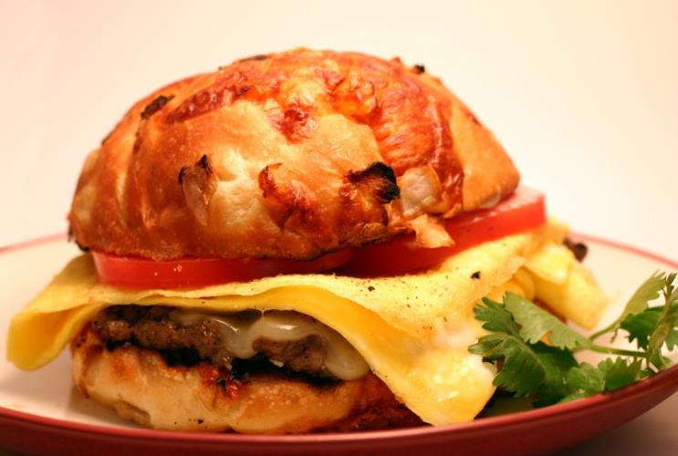
Food Safety
Is the responsibility of producers, processors and the consumer
Can be managed to reduce the incidence of foodborne illness and infection

Slide 175
HACCP
Stands for Hazard Analysis Critical Control Points
Is a program adopted by most commercial food processors to control hazards in food processing
Identifies critical points where contamination occurs in a product and presents solutions
example:
Problem: shipping dock can allow for entry of rodents Solution: install closed container rodent traps and seal door properly

Slide 176
HACCP
Is composed of seven principles:
conduct a hazard analysis
identify critical control points (CCPs)
establish critical limits for each critical control point
establish critical control point monitoring requirements
establish corrective actions
establish record keeping procedures
establish procedures for verifying the HACCP system is working as intended

Slide 177
Ways to Minimize Foodborne Bacteria
Include:
cooking
pasteurization
canning
freezing
irradiation
proper storage temperatures
high pressure treatment
acidification
Safety Second: The minimum internal temperature for ground meat products is 160ºF (71ºC). Whole muscle product surfaces should be cooked to 160ºF (71ºC).

Slide 178
Irradiation
Destroys pathogenic and spoilage bacteria in food
Does not alter the freshness, nutritional content, physical or chemical composition, aroma, or taste of a food
Can be performed on fresh meats, processed meats and spices

Slide 179
Irradiation
Involves exposing food to a source of ionizing energy
gamma rays
machine generated electrons
x-rays
Does NOT result in radioactive food
product never comes into contact with radioactive material and no residue results from process

Slide 180
Proper Storage Temperatures
Are usually not followed, resulting in exponential growth of bacteria
Include:
below 40ºF (4ºC) for cold products
above 140ºF (60ºC) for hot products
140ºF (60ºC)
40ºF (4ºC)

Slide 181
The Temperature Danger Zone
Is between 40ºF (4ºC) and 140ºF (60ºC)
Is the range in which most foodborne pathogenic bacteria thrive
Can be avoided by:
properly cooking all foods
heating foods to the proper temperature before serving
quickly cooling all food products
Safety Second: Food held for more than four hours in the temperature danger zone should be discarded.

Slide 182
Foodborne Illness
Is most commonly caused by mishandling food
temperature abuse
cross-contamination
improper procedures
contamination after cooking

Slide 183
Vulnerable People
Include:
senior citizens
pregnant women
young children
individuals with compromised immune systems
cancer
diabetes
liver disease
AIDS

Slide 184
Foodborne Illness
Can be a food infection or food intoxication
food infection: pathogenic bacteria was in a food product consumed and made the consumer sick after eating
Salmonella spp.
food intoxication: pathogenic bacteria grew in the food, produced a toxin and made the consumer sick after eating
Clostridium botulinum

Slide 185
Bacterial Counts
Which cause illness differ for each bacteria
some bacteria require higher numbers to be consumed to make an individual ill
the more bacteria consumed, the more likely a person is to get sick

Slide 186
Common Foodborne Bacteria
Illness | Botulism, food intoxication
Causative Agent | Toxins produced by Clostridium botulinum
Symptoms | Nausea; vomiting; fatigue; dizziness; headache; dryness of skin; constipation; impaired swallowing, speaking, respiration and coordination; double vision Ten percent of cases are fatal
Time of Onset | 12 to 72 hours after consumption
Meat Usually Involved | Canned meats and seafood; smoked and processed meats and seafood
Preventative Measures | Canning at 176ºF (80ºC) for ten minutes; proper smoking and processing procedures; use of nitrites; proper cooking and refrigeration temperatures; sanitation

Slide 187
Common Foodborne Bacteria
Illness | Staphylococcal food infection
Causative Agent | Enterotoxin produced by Staphylococcal aureus
Symptoms | Nausea; vomiting; abdominal pain due to inflammation of the lining of the stomach and intestines
Time of Onset | 12 to 48 hours after consumption
Meat Usually Involved | Canned meats and seafood; smoked and processed meats and seafood; foods prepared by hand which do not require heating before consumption
Preventative Measures | Canning at 176ºF (80ºC) for ten minutes; proper smoking and processing procedures; use of nitrites; proper cooking and refrigeration temperatures; sanitation

Slide 188
Common Foodborne Bacteria
Illness | Perfringens food infection
Causative Agent | Clostridium perfringens
Symptoms | Nausea; occasional vomiting; abdominal pain; diarrhea
Time of Onset | 8 to 24 hours after consumption
Meat Usually Involved | Cooked meat, poultry and fish held at non-refrigerated temperatures for long periods of time
Preventative Measures | Prompt refrigeration of unconsumed cooked meat, gravy and fish; maintenance of refrigeration equipment; sanitation

Slide 189
Common Foodborne Bacteria
Illness | Salmonellosis, food infection
Causative Agent | Salmonella spp., over 1,200 species of Salmonella cause illness when ingested
Symptoms | Nausea; vomiting; abdominal pain; diarrhea; fever; possible chills and headache
Time of Onset | 12 to 24 hours after consumption
Meat Usually Involved | Insufficiently cooked or re-heated meat, poultry and eggs; products kept unrefrigerated for long periods of time
Preventative Measures | Properly cooking food products; proper refrigeration and packaging; cleanliness of food handlers; sanitation of equipment

Slide 190
Common Foodborne Bacteria
Illness | Listeriosis, food infection
Causative Agent | Listeria monocytogenes
Symptoms | Fever; headache; nausea; vomiting; monocytosis, meningitis; septicemia; miscarriage; localized external and internal lesions; pharyngitis
Time of Onset | Unknown, approximately four days to three weeks after consumption
Meat Usually Involved | Eggs; processed meats; fresh meats and poultry products; raw and smoked fish
Preventative Measures | Proper hygiene practices; sanitation of equipment and facilities

Slide 191
Common Foodborne Bacteria
Illness | Trichinosis, food infection
Causative Agent | Trichinella spiralis, a nematode worm
Symptoms | Nausea; vomiting; diarrhea; profuse sweating; fever; muscle soreness
Time of Onset | 2 to 28 days
Meat Usually Involved | Improperly cooked pork and products containing pork
Preventative Measures | Cooking pork to at least 137ºF (58ºC); freezing and storage of uncooked pork at 9ºF (-12ºC) or lower for a minimum of 20 days; avoid feeding swine raw garbage

Slide 192
Common Foodborne Bacteria
Illness | E. coli, E. coli O157:H7; food infection
Causative Agent | Escherichia coli
Symptoms | Severe abdominal cramps; bloody diarrhea; nausea; vomiting; diarrhea; possible complications from hemolytic uremic syndrome
Time of Onset | 3 to 4 days
Meat Usually Involved | Raw and undercooked meat
Preventative Measures | Cooking all ground meat to an internal temperature of 160ºF (71ºC); cooking all exposed surfaces of whole muscle products to an external temperature of 160ºF (71ºC)

Slide 193
Resources
“Lessons on Meat.” National Livestock and Meat Board, Beef Promotion and Research Board, and National Pork Board. 1991.
Savell J.W., Smith G.C. (2009). Meat Science Laboratory Manual. (8 ed.). American Press.
Romans, J. R., Costello, W. J., Carlson, W. C., Greaser, M. L., & Jones, K. W. (2000). The Meat We Eat. (14 ed.). Prentice Hall.
“The Guide to Identifying Meat Cuts. Cattlemen’s Beef Board and National Cattlemen’s Beef Association. 2009.
“The Seven HACCP Principles.” Food Safety and Inspection Service. (1998). Retrieved 2011 from: http://www.fsis.usa.gov/oa/background/keyhaccp.html
United States Department of Agriculture. USDA. Retrieved 2011: http:// www.usda.gov
“Yellow pages- answers to predictable questions consumers ask about meat and poultry.” American Meat Institute Foundation, Washington, D.C. 1994.

Slide 194
Committee Members
Chairman Randy Harp, Ph.D., Tarleton State University, Professor of Animal Sciences, Stephenville, Texas
Co-Chariman Jodie Pitcock, USDA Market Reporter, USDA Livestock & Grain Market News
William Benjy Mikel, Ph.D., Associate Vice President, International Programs. Executive Director, International Institute. Director, Food Science Institute. Mississippi State University

Slide 195
Committee Members
Rudy S. Tarpley, Ph.D., Associate Professor & Head, Agricultural & Consumer Sciences, Tarleton State University, Stephenville, Texas
Renée Gebault-King, Ph.D. Candidate, Soil Science, Renewable Resources Department, University of Wyoming, Laramie, Wyoming
David Bishop, Turks Meat Market, Ashland, Ohio

Slide 196
Acknowledgements
Production Coordinators
Olivia Mitchell Kelly Adams
Graphic Designers
Daniel Johnson
Melody Rowell
Technical Writer
Jessica Odom
Production Manager
Maggie Bigham
Brand Manager
Clayton Franklin
Reviewed By
Dale R. Woerner, Ph.D
Assistant Professor, Center for Meat Safety & Quality, Department of Animal Sciences, Colorado State University
Executive Producers
Gordon W. Davis, Ph.D.
Jeff Lansdell
© MMXII
CEV Multimedia, Ltd.

